Slide 1
Instrumental_acquisition Spel: kortlekdragning Tema: inget Funktioner ej visade i mockup: # Saldoräknare

Slide 2
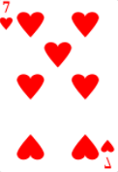
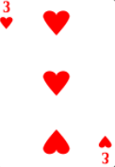
Let’s play
Card Match!

Slide 3
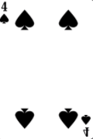
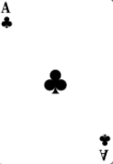
≠
?
?
A
S
-20

Slide 4
You win!
?
?
A
S
+ 100

Slide 5
Pavlovian_acquisition Spel: enarmad bandit Tema: S1 (”Stardust”) eller S2 (”Texas”), vardera presenterad lika många gånger men i slumpad ordning Funktioner ej visade i mockup: # Saldo

Slide 6
Let’s play
Slot Machines!

Slide 7

What are your chances of winning?
Q
W
E
R
High
Low
Zero
Don’t know

Slide 8



BAR
BAR
BAR
BAR
BAR
BAR
BAR
BAR
BAR
BAR
BAR
BAR
BAR
BAR
BAR
BAR
BAR
BAR

Slide 9

What are your chances of winning?
Q
W
E
R
High
Low
Zero
Don’t know

Slide 10
BAR
BAR
BAR
BAR
BAR
BAR
BAR
BAR
BAR
BAR
BAR
BAR
BAR
BAR
BAR
BAR
BAR
BAR

Slide 11
What are your chances of winning?
Q
W
E
R
High
Low
Zero
Don’t know

Slide 12
BAR
BAR
BAR
BAR
BAR
BAR
BAR
BAR
BAR
BAR
BAR
BAR
BAR
BAR
BAR
You win!
BAR
+ 20
BAR
BAR

Slide 13
What are your chances of winning?
Q
W
E
R
High
Low
Zero
Don’t know

Slide 14
BAR
BAR
BAR
BAR
BAR
BAR
BAR
BAR
BAR
BAR
BAR
BAR
BAR
BAR
BAR
BAR
BAR
BAR

Slide 15
Transfer_test Spel: kortleksdragning Tema: S1 (”Stardust”) eller S2 (”Texas”), vardera presenterad lika många gånger men i slumpad ordning Funktioner ej visade i mockup: # Saldo

Slide 16
Let’s play
Card Match!

Slide 17
What are your chances of winning?
Q
W
E
R
High
Low
Zero
Don’t know

Slide 18
≠
?
?
A
S
-20

